Slide 1
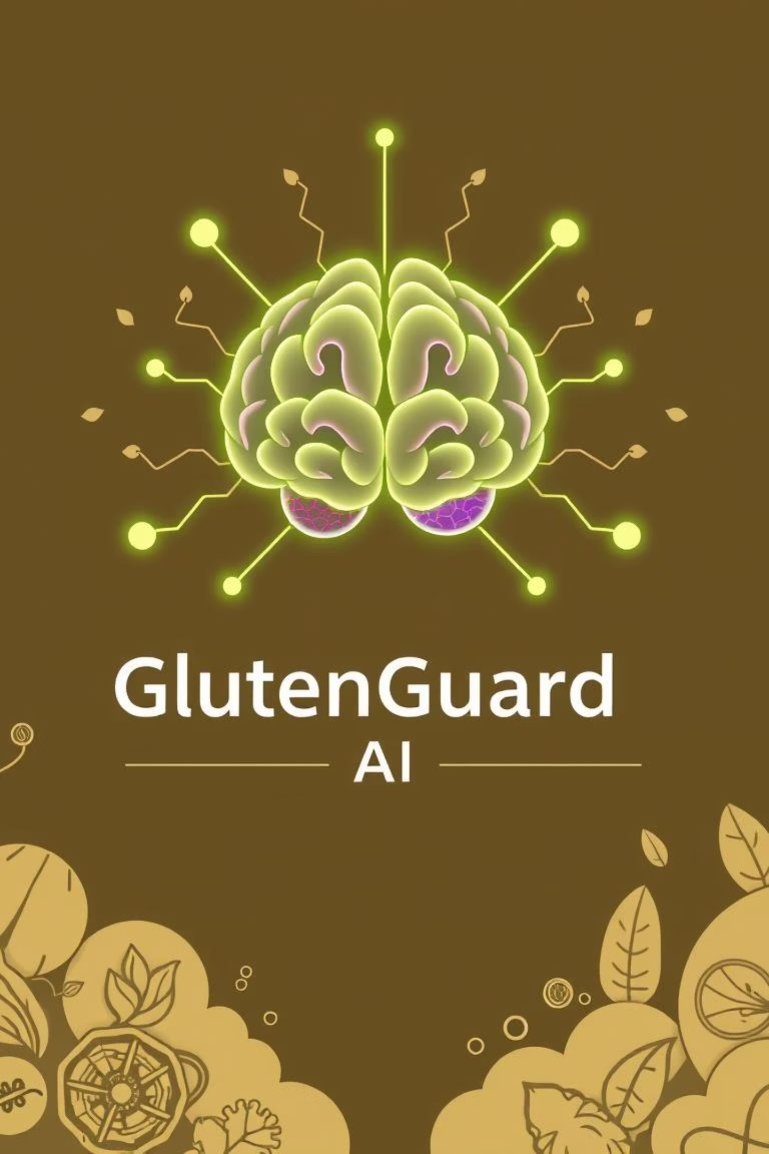
GlutenGuard AI: Project Proposal
CS4063 - Natural Language Processing
Group Members
Awais Naeem
M Ejaz Alvi
Qazi Mohib
Haider Rizvi
Saim
Abdul Moiz

Slide 2
GlutenGuard AI: Accelerating Diagnosis
GlutenGuard AI is an intelligent multi-modal system designed to accelerate gluten intolerance diagnosis from 6-10 years to just 6 weeks.
NLP
Computer Vision
Statistical Agents
Correlates meals and symptoms.
Detects food items.
Analyzes patterns for diagnosis.

Slide 3

The Problem: Slow & Costly Diagnosis
Gluten intolerance diagnosis is slow, expensive, and unreliable, often taking 6-10 years.
Manual tracking of meals and symptoms is challenging.
Hidden gluten in processed foods is hard to identify.
Correlating symptom patterns with diet is complex.
Current methods are tedious, error-prone, and costly.

Slide 4



Target Users & Importance
Symptomatic Sarah
Health-Conscious Henry
Diagnosed Dana
Seeks fast, accurate pattern detection for undiagnosed symptoms like bloating and fatigue.
Wants data-driven proof for suspected gluten sensitivity, frustrated by manual food diaries.
Needs tools to avoid hidden gluten in real-time after diagnosis.
Undiagnosed gluten intolerance affects over 20 million Americans, leading to chronic issues and high medical costs. Early detection is crucial.

Slide 5

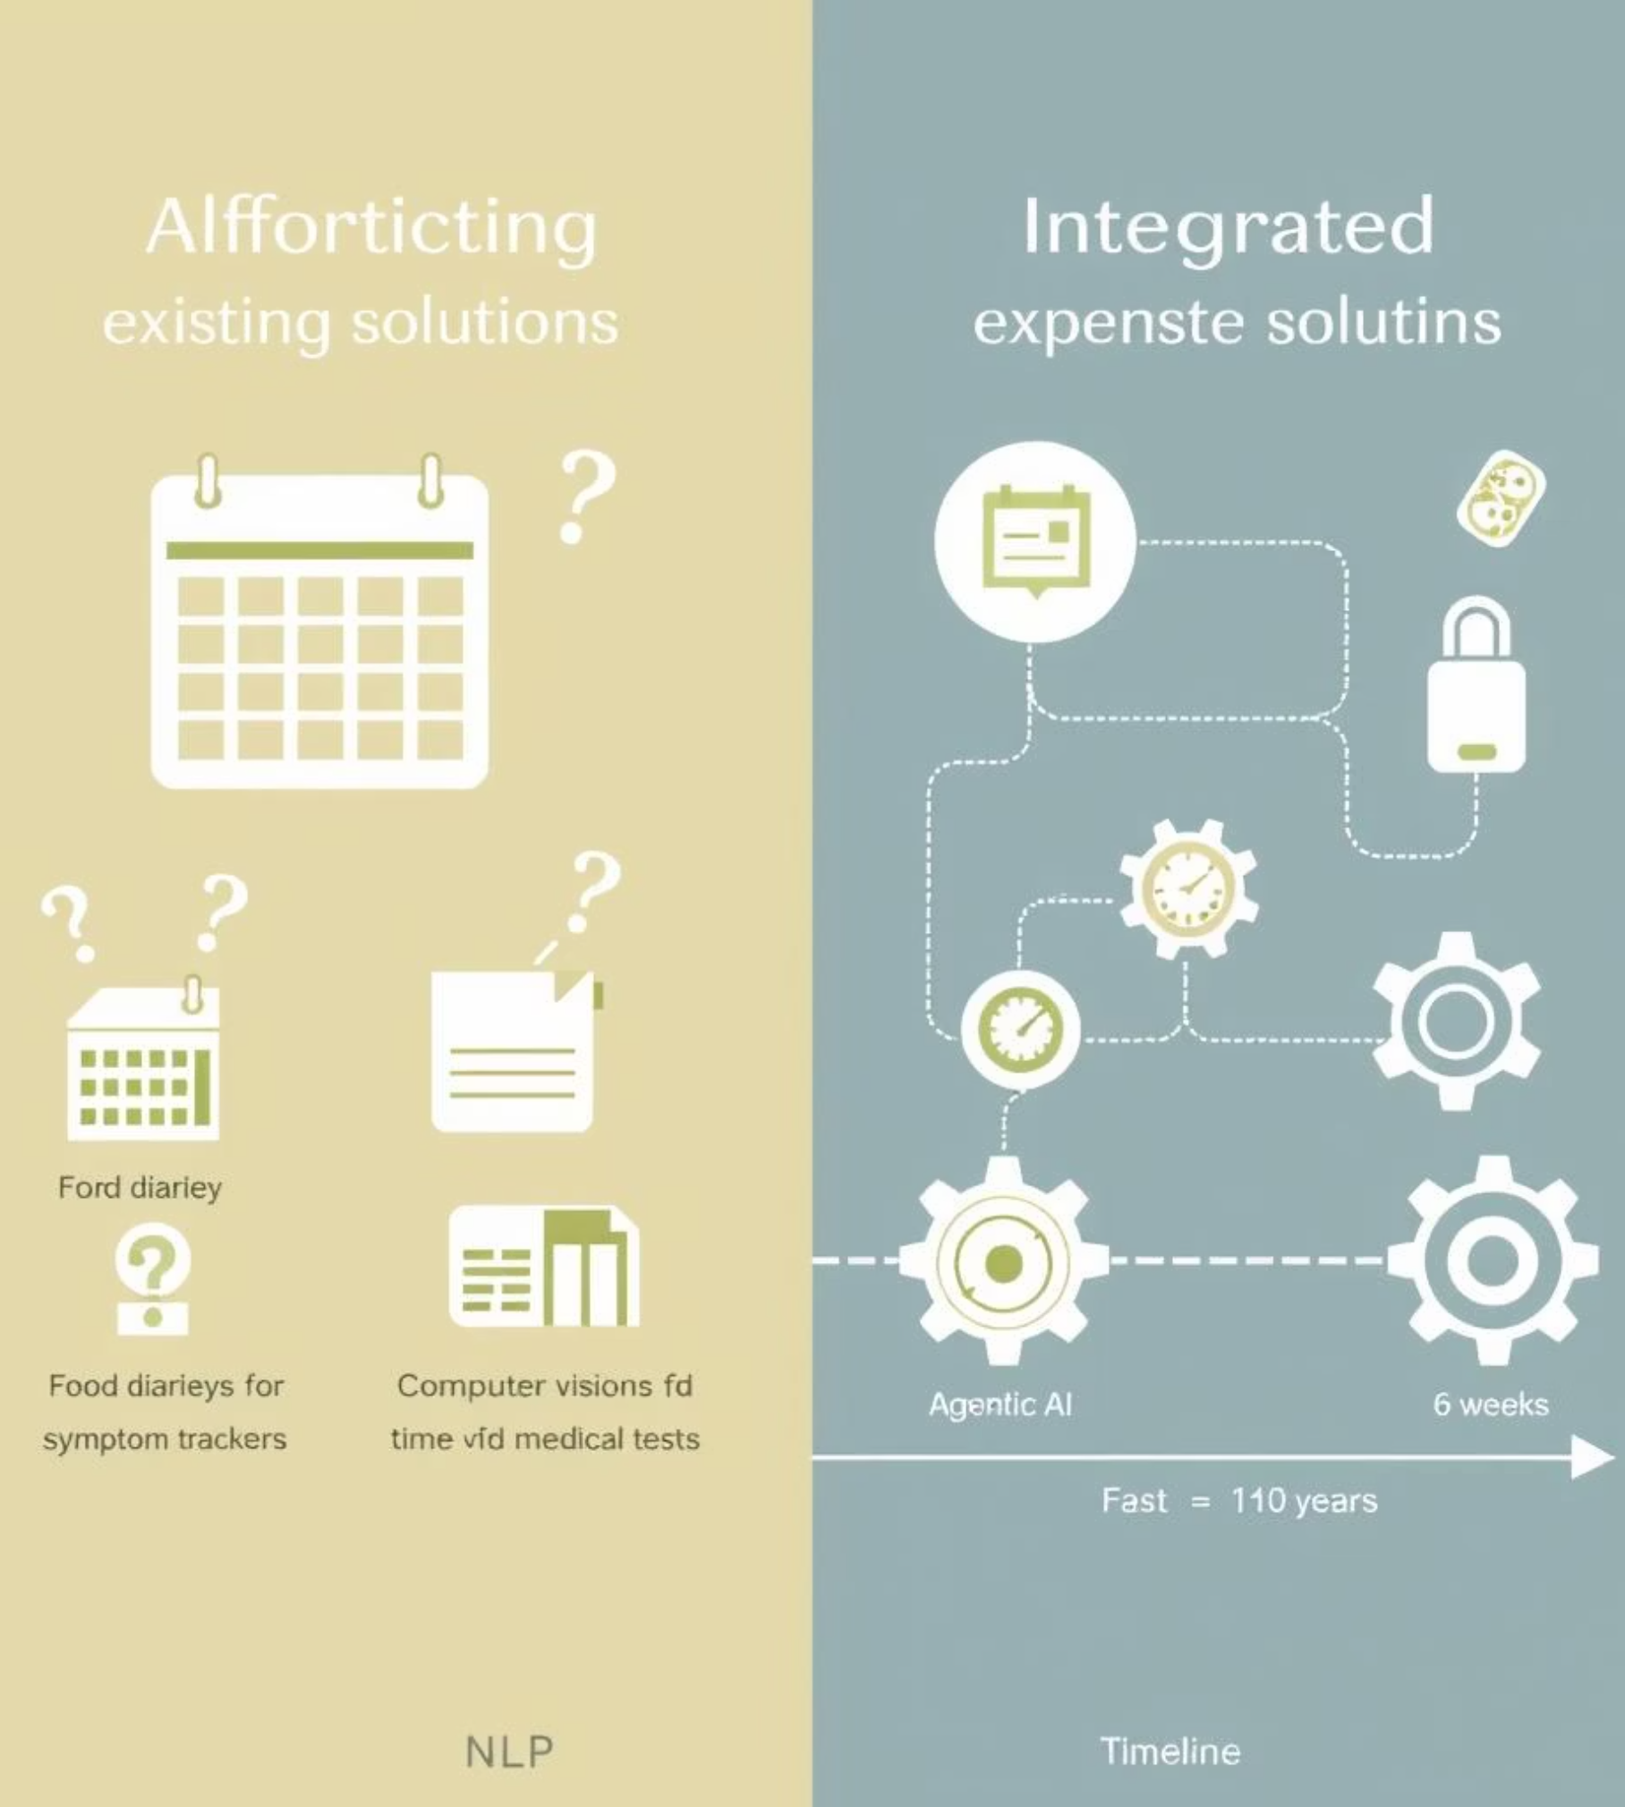
Market Need & Value Proposition
Existing solutions lack integrated multi-modal input, automated gluten risk assessment, and statistically rigorous pattern detection.
Existing Gaps
No intelligent pattern detection in food diaries.
Symptom trackers don't integrate with food tracking.
Medical tests are expensive, invasive, and time-consuming.
Our Solution
GlutenGuard AI combines NLP, computer vision, and agentic AI to provide automated, data-driven insights.
Reduces diagnosis time from 6-10 years to 6 weeks.

Slide 6

Value Creation
For Users
For Healthcare Providers
Overall
Time and cost savings, peace of mind, improved health via faster treatment.
Reduces system burden, enables patients to arrive with pre-analyzed data, leading to better outcomes.
100% free and open-source, making it accessible and extensible to all.

Slide 7

User Journey: Symptomatic Sarah
Sarah, a 32-year-old software engineer, suspects gluten intolerance. GlutenGuard AI guides her to a data-driven diagnosis.
Weeks 1-2: Data Collection
1
Upload food photos, log symptoms via text, view real-time stats on dashboard.
2
Weeks 3-4: Pattern Detection
Generate correlation reports, including time-lag analysis and dose-response insights.
Weeks 5-6: Decision Phase
3
Receive final report with statistical evidence, recommendations, and data to share with doctors.

Slide 8
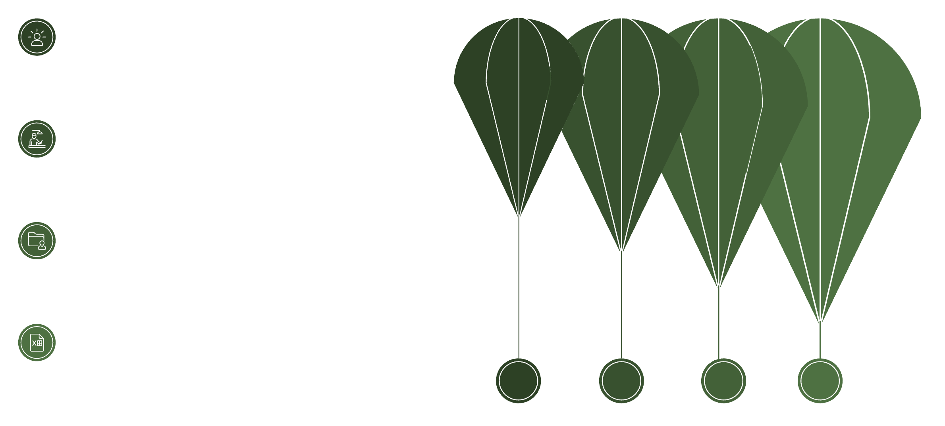




High-Level System Pipeline
User Input
Text or photo submission
Processing Agents
NLP, Vision, and Analysis
Storage
SQLite and FAISS indexing
API Output
Logs, scores, and reports
1
2
3
NLP Agent
Computer Vision Agent
Analysis Agent
Handles text inputs for meals and symptoms.
Processes food photos for detection and gluten risk.
Performs statistical correlations on stored data.

Slide 9
Agentic AI Design & Architecture
We use LangChain for orchestration, integrating specialized agents and robust backend services.
Agent Framework
LangChain (v0.0.350) for orchestration and tool integration.
Three specialized agents: NLP, Computer Vision, Analysis.
Tools: spaCy, Transformers, OpenCV, HuggingFace, SciPy, Pandas, NumPy.
Technical Architecture
Vector Store: FAISS for semantic search (future), SQLite for structured data.
Models: Groq Vision API (primary), HuggingFace (fallback), spaCy, Transformers.
Backend: FastAPI for speed and async support.

Slide 10
Feasibility & Success
GlutenGuard AI is highly feasible, leveraging proven, free tools and a clear development roadmap.
90%
2s
Response Accuracy
Latency
Food detection accuracy.
Photo processing time.
99%
5min
Reliability
User Satisfaction
System uptime.
Workflow completion time.
This project aligns with course requirements for agentic AI, backend engineering, and deployment. We aim to deliver a deployable system by December 11, 2025.

Slide 11
THANK YOU

